Slide 1
Applying Learning Science to Improve Transfer in Introductory Statistics
Adam B. Blake, Laura C. Fries,
Ji Y. Son, & James W. Stigler
Psychonomic Society Annual Meeting
Montréal, Québec, Canada
Saturday, November 16, 2019
Notes:
This is a two-layer project:
How to get research into practice
How to improve students learning of things that are hard to learn
A different type of talk
I’m a postdoc at…

Slide 2
What is learning in education?
Your preparation for the real world is not in the answers you’ve learned, but in the questions you’ve learned how to ask yourself.
-Bill Waterson
Notes:
- What do we consider learning? + Building a deep understanding that is flexible and applicable to new contexts + New contexts: environments, mindsets, concepts + Consider the students that say * "that was tricky" * "you changed it a bit" - Transfer (here) is not new datasets, it is extending to new contexts

Slide 3
The Practicing Connections Hypothesis
Fries, L. C., Son, J., & Stigler, J. W. (2019).
Practicing connections: A framework to guide instructional design for developing understanding in complex domains.
Manuscript submitted for publication.

Slide 4
Teaching for understanding and transfer
Not what teachers do, but the learning opportunities they create.
Notes:
Cross-cultural research, and MET study show: quality teaching not defined by its features and actions but by the opportunities created for students to learn.
Same teacher action can have different effects in different cultures; different actions required to have a similar effect.

Slide 5
Three Types of Learning Opportunities Required for Deep Learning
Productive struggle
Explicit connections
Deliberate practice
Notes:
To learn hard things deeply over time, students need recurring and sustained opportunities for:
Productive struggle – with important mathematics
Explicit connections – among concepts, procedures, representations, situations
Deliberate practice – increasing variation and complexity over time

Slide 6
Learning Opportunities: Summary
Explicit Connections
− +
Step-By-Step Procedures | Well-Formed Lecture
Discovery Learning | Practicing Connections
−
+
Productive
Struggle

Slide 7
Learning Opportunities: Summary
Explicit Connections
− +
✪
Step-By-Step Procedures | Well-Formed Lecture
Discovery Learning | Practicing Connections
✪
−
+
✪
Productive
Struggle
Notes:
Deliberate Practice
Maintaining
struggle and connections
through time

Slide 8
Building Transferable Knowledge in Statistics & Data Science

Slide 9
What does it look like to deliberately practice these connections?
Notes:
So armed with our ingredients -- what does it look like to practice making them? In statistics?
Let’s consider a hypothetical study where

Slide 10
Statistics: The “Bits” We Teach
Statistic
Parameter
Sum of squares
Variance
Standard deviation
T-test
Correlation
Regression
Experiment
Random assignment
Random sample
Null hypothesis
Alternative hypothesis
Z-score
Z distribution
p < .05
Random variable
Quartiles
Interquartile range
Sampling distribution
Randomization test
Confidence interval
Sampling variation
Model
Chi-square
ANOVA
Normal distribution
Margin of error
F-test
Paired t-test
Students learn the pieces,
don’t see the connections, and can’t transfer to new contexts.
Notes:
Turns out introductory statistics is a great domain to work teaching hard things to all students.
Data science is more relevant than ever before
It’s hard
And lots of students take it at every level
Traditionally taught as lots and lots of useful tools that you need to know when to use, but not as a cohesive approach

Slide 11
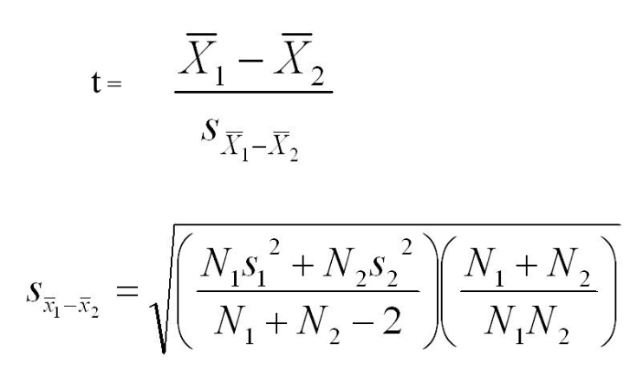
Bits Approach: t-test
t = -1.818
p = .081
Notes:
The bits approach to this situation would be to say -- hey let’s calculate means and the t-statistic and check the p-value… oh it’s not p less than .05… typically the independent samples t-test is one unit (or a chapter) in the course...
What would the practicing connections approach do differently?

Slide 12
Build a cohesive set of concepts to connect over time

Slide 13
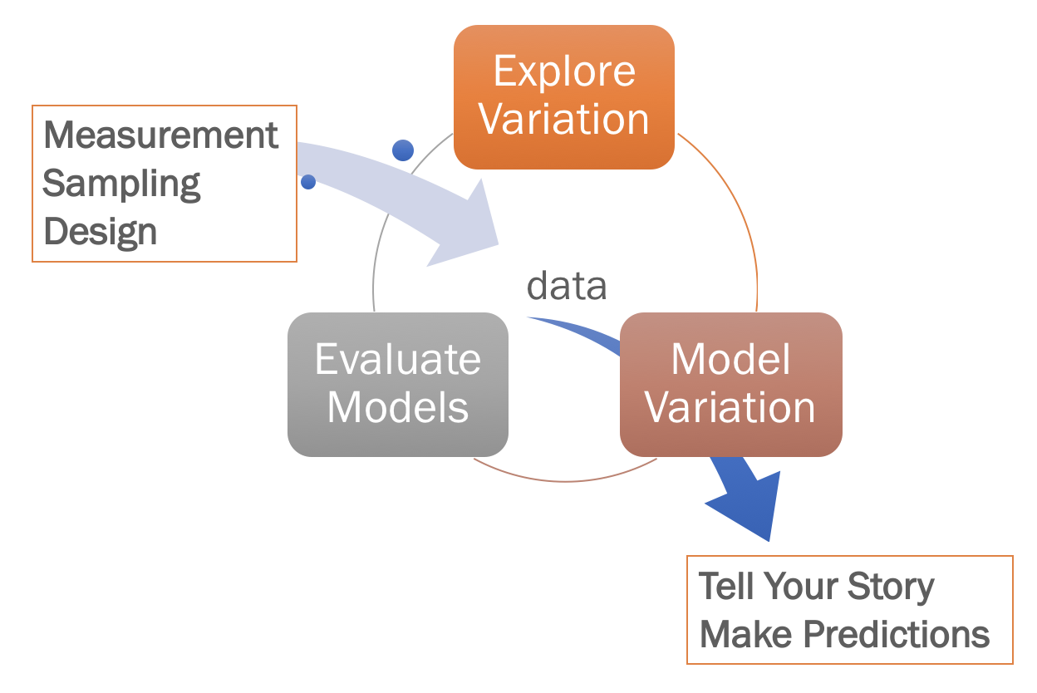
Doing Statistics in The World
Notes:
The world in statistics is at least in part what it means to do statistics in the world.
Traditional classes focus on learning a lot of statistical tests; sometimes even on hand calculation.
But that’s not what people really do with data in the world. We focus on the PRACTICE of data analysis:
Variation is why statistics exist -- if everyone who got some medical treatment got better, then we wouldn’t need statistics. We need stats because even with an effective treatment, there is variation!
exploring variation, modeling variation, and evaluating models.

Slide 14
Core Concepts
DGP Population
Statistical Model
Distribution Triad
Randomness
Statistical Model
Sample Data
Sampling Distribution
Notes:
Distributions are how we see variation; we build models of distributions; and we instantiate those models as a process so we have identified something we call the distribution triad, the concept of a statistical model, and randomness as a process as core concepts.
It’s easy to just list them
hard to actually teach students these concepts in a meaningful way.

Slide 15
DATA = MODEL + ERROR
Notes:
From the beginning we teach the idea that D = M + E
This is frequently connected to new representations over time

Slide 16
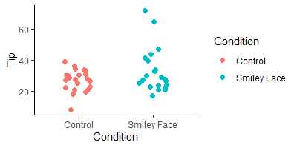
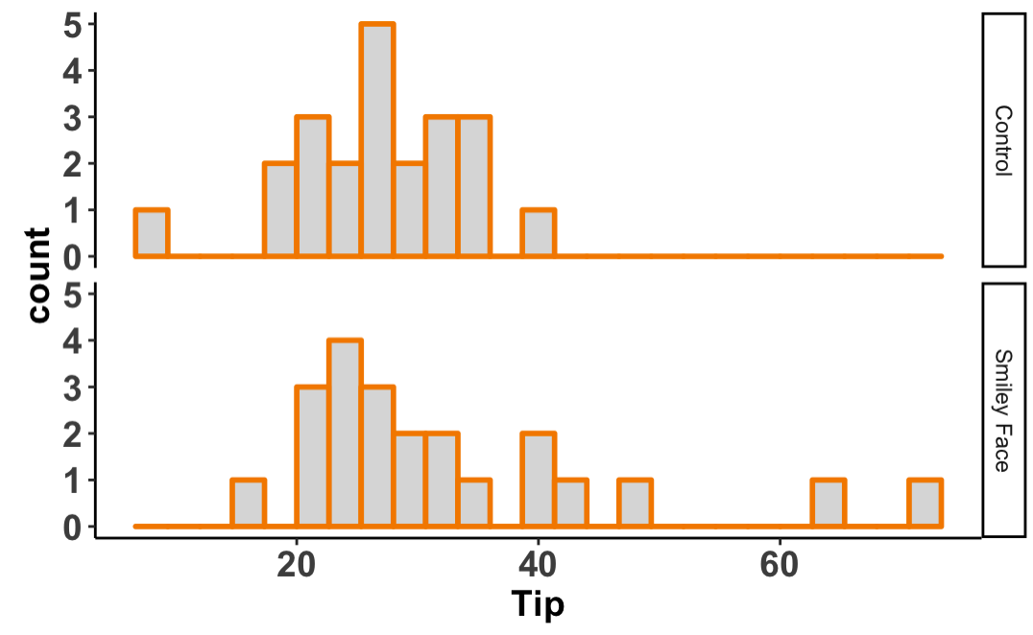
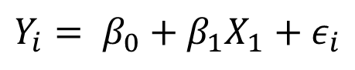
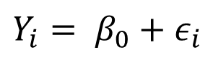
Practice with Varying Representations
DATA = MODEL + ERROR
Tips = Quality of Service + other stuff
Tips = other stuff
$$Y_{i}= β_{0}+β_{1}X_{1}+ε_{i}$$
$$Y_{i}= β_{0}+ε_{i}$$
lm(Tip ~ Condition, data = TipExperiment)
lm(Tip ~ NULL, data = TipExperiment)
gf_histogram(~Tip, data = TipExperiment) %>%
gf_facet_grid(Condition ~ .)
gf_jitter(Tip ~ Condition, data = TipExperiment)

Slide 17
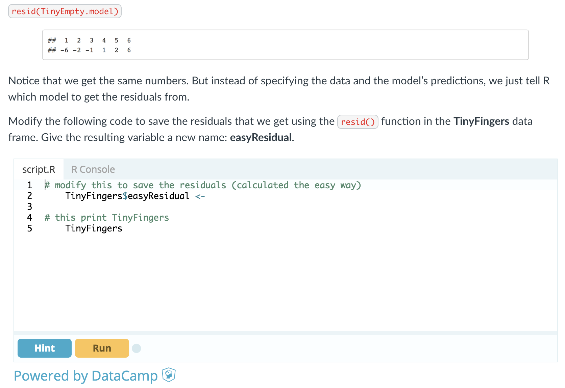
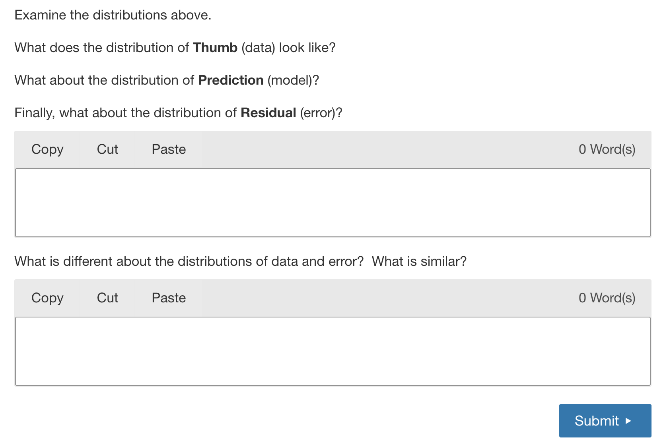
A Fully Instrumented Interactive Textbook
1200+ formative assessments
Pages interleave components (narrative, video, R exercises, questions)

Slide 18
Explore Variation
Notes:
We would start with a variation -- recognizing it and exploring it.

Slide 19
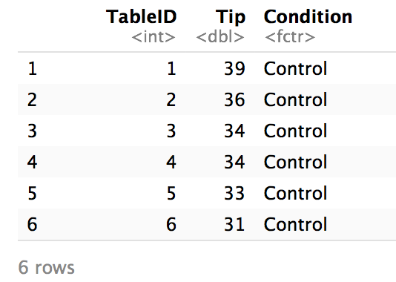
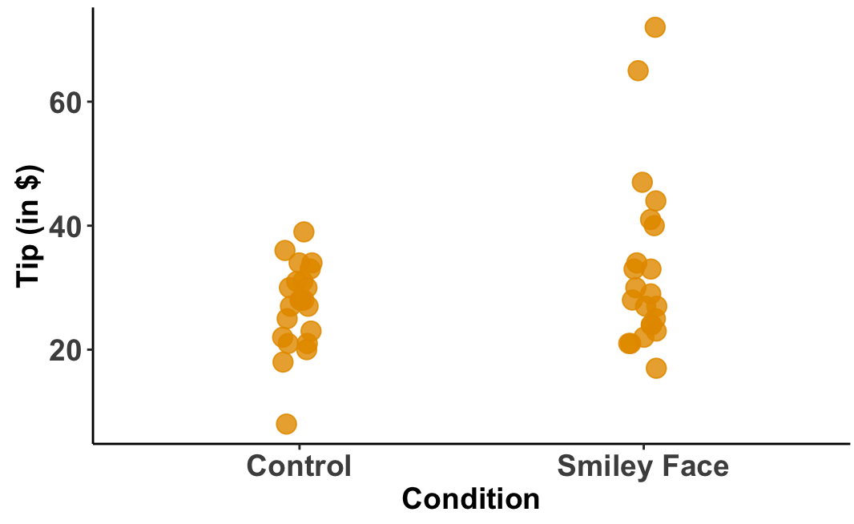
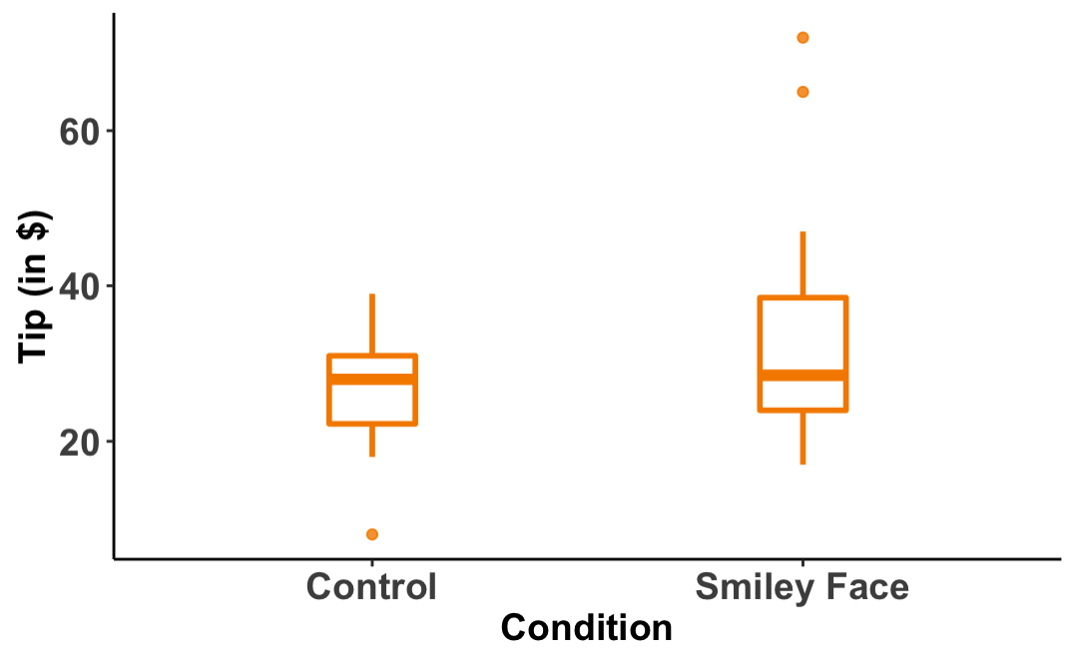
Connecting Representations

Slide 20
Connecting Representations
Tips = Condition + other stuff
boxplot(Tip ~ Condition,...)

Slide 21
Model Variation
Notes:
Now there is actually a need to build formal models of variation...

Slide 22
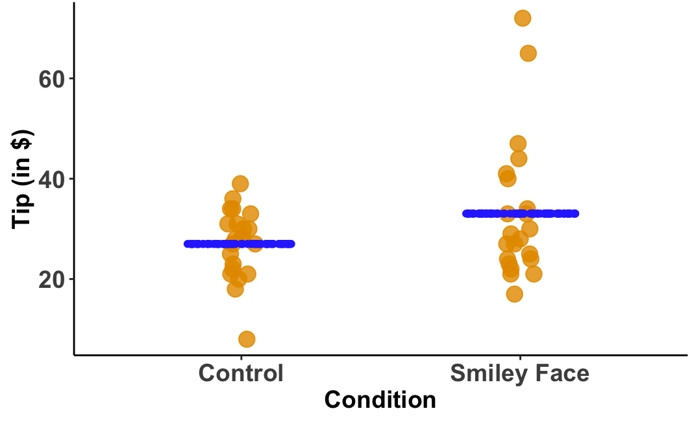
From Informal to Formal Models
Tip_{i} = β₀ + β₁ Condition_{i} + ε_{i}
Y_{i} = β₀ + β₁ X_{i} + ε_{i}
Data Generating Process
Y_{i} = β₀ + ε_{i}
Y_{i} = b₀ + b₁ X_{i} + e_{i}
lm(Tip ~ Condition,...)
Notes:
To fit models, students write R code that is very similar to much of the syntax they used for exploring data through visualizations…
now that this syntax is more familiar, we get students to stretch themselves and make connections to the general linear model notation. They fit very simple models and realize that when we make a model, it suddenly reveals error. Before --we just had variation but now we have partitioned that variation into the model part and the error part.

Slide 23
Making Connections
Y_{i} = b₀ + b₁ X_{i} + e_{i}
Y_{i} = 27 + 6X_{i} + e_{i}
b₀=$27
b₁= $6

Slide 24
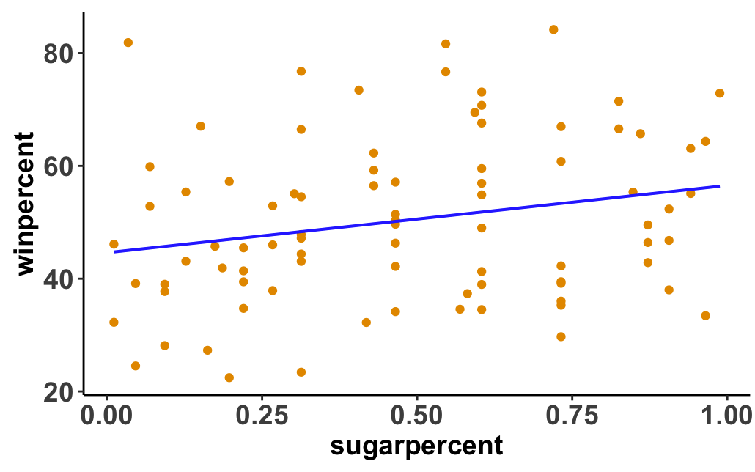
Making Connections
Y_{i} = b₀ + b₁ X_{i} + e_{i}
Y_{i} = 44 + .11X_{i} + e_{i}
b₀= 44
b₁= .11
Notes:
Causal learning: small changes so that students can see what is being altered

Slide 25
Evaluate Models

Slide 26
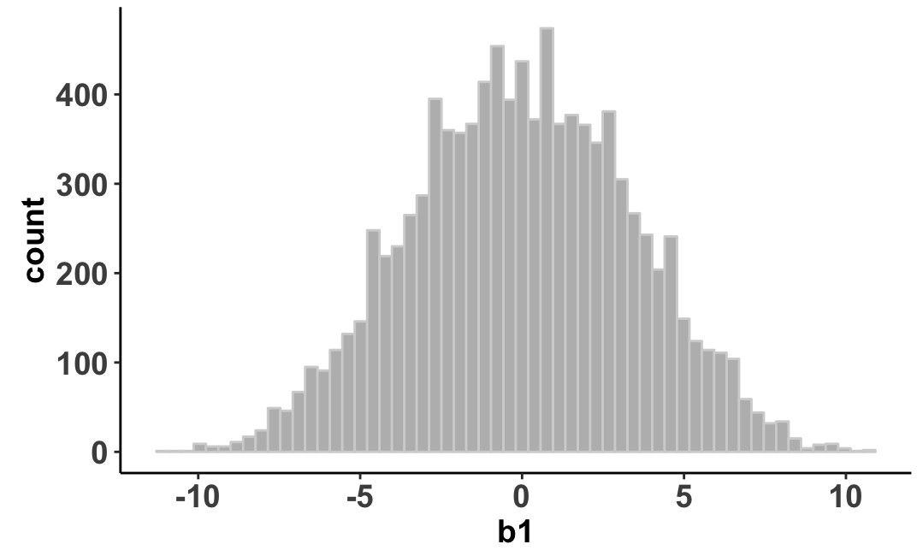
From Informal to Formal Models
Tip_{i} = β₀ + β₁ Condition_{i} + ε_{i}
Y_{i} = β₀ + β₁ X_{i} + ε_{i}
Data Generating Process
Y_{i} = β₀ + ε_{i}
Y_{i} = b₀ + b₁ X_{i} + e_{i}
lm(Tip ~ Condition,...)
Sampling Distribution
b₁
Notes:
Students learn to bootstrap sampling distributions
Students can see that it is possible to have generated a difference of $6 purely from shuffling… and we talk about our statistics’ community’s norms for what counts as likely or unlikely to have been generated by one process or another.
There are a lot of other ideas we get into but this is to give you a flavor of the difference when we take a practicing connections approach to learning hard things.

Slide 27
More Complex than Teaching t-tests… What do you get for it?
Notes:
PAUSE
This is a lot of work. Is there a payoff?

Slide 28
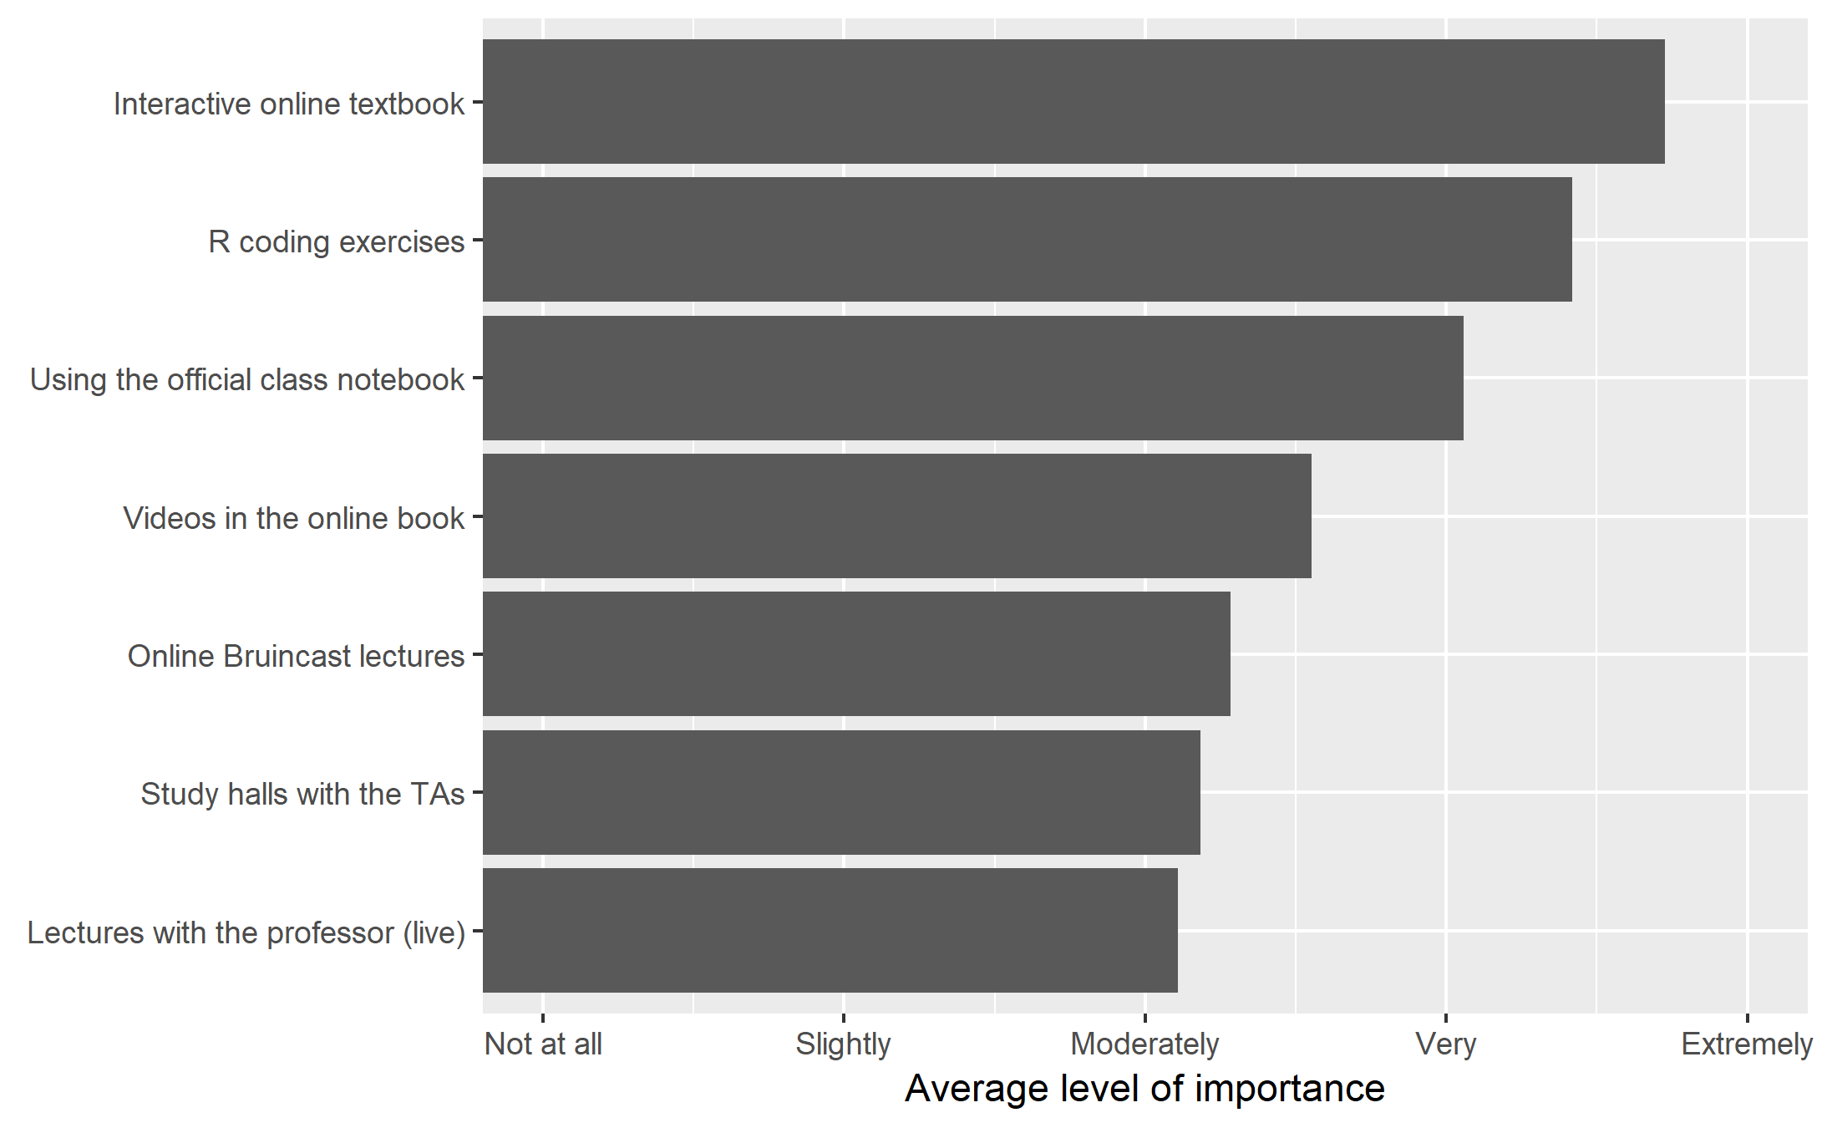
How important were each of the following in helping you learn the content of this course?

Slide 29
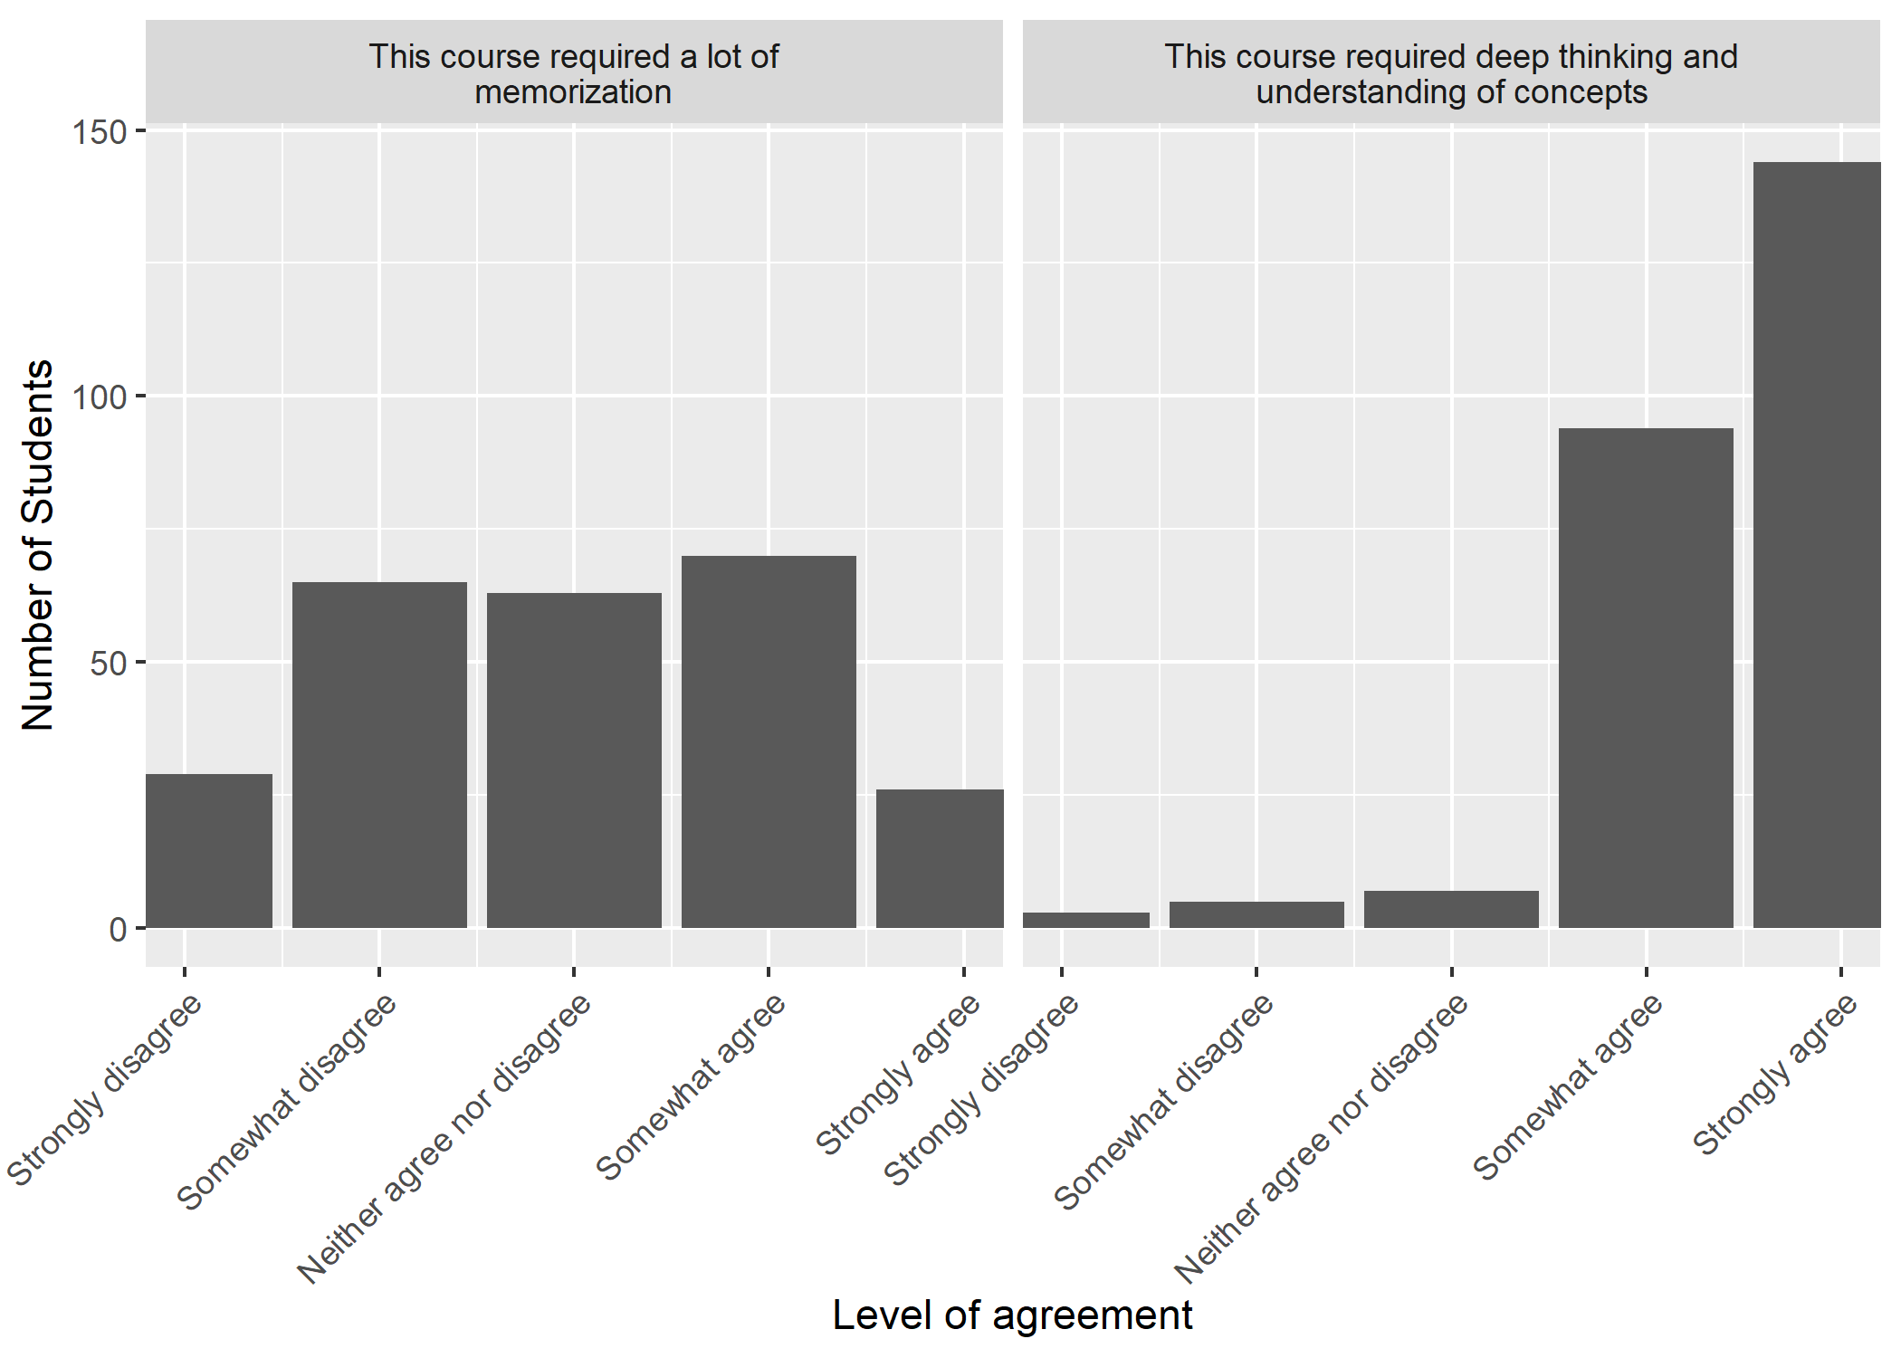
What kind of thinking did students do?

Slide 30
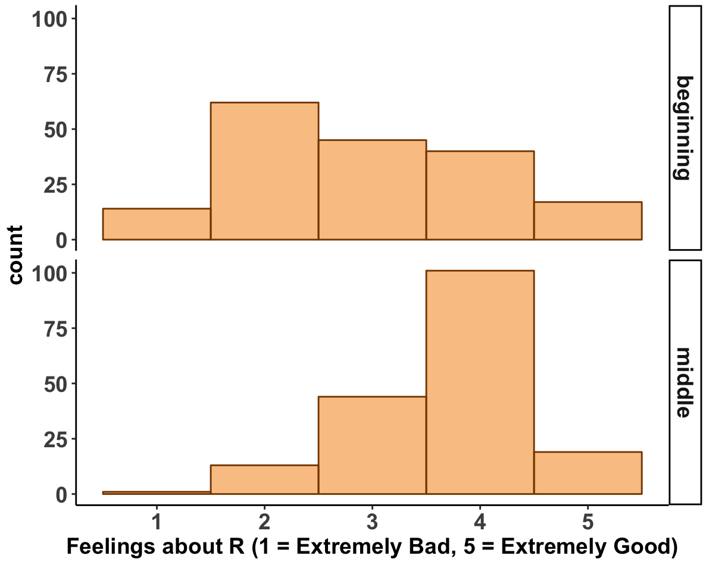
Practical and Psychosocial Benefits
How do you feel about learning R?
◀︎ Extremely bad Extremely good▶︎
Notes:
You get a lot: students like it, they are able to do data analysis, practical skills...
For example, our students are non-stem and are not happy about programming.

Slide 31
Transferable Knowledge?
Notes:
But remember, we embarked on this crazy stuff not so students could like programming… but to foster transferable knowledge in a complex domain. To us, this is the most exciting outcome.

Slide 32
By using Practicing Connections Framework
Easy transition from ANOVA to Regression
Notes:
In the course we cover through simple regression models with single predictors
Two group models
Three group models
Simple regression models
The following questions were scored as extra credit on the final. Students knew that the information was not something that they had necessarily studied.

Slide 33
Conceptual Preparation
Does their knowledge prepare them to learn new concepts with ease

Slide 34
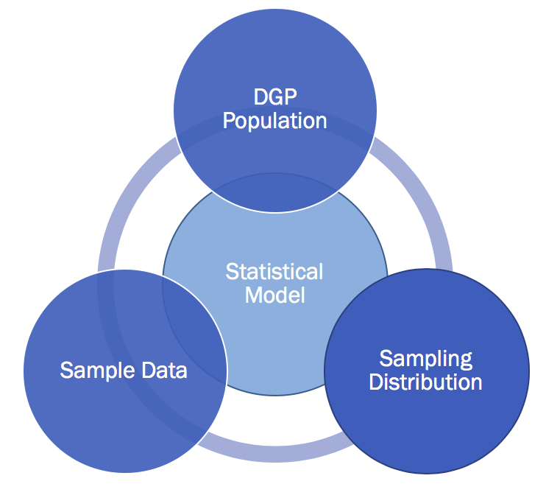
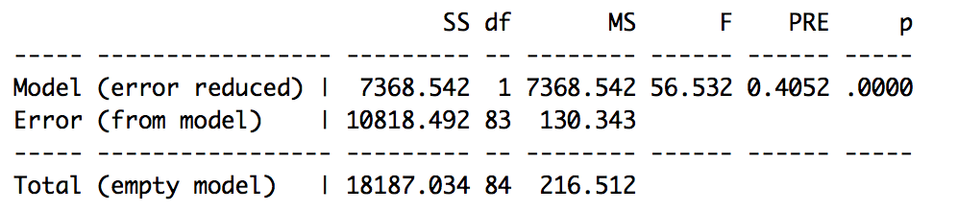
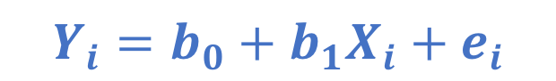
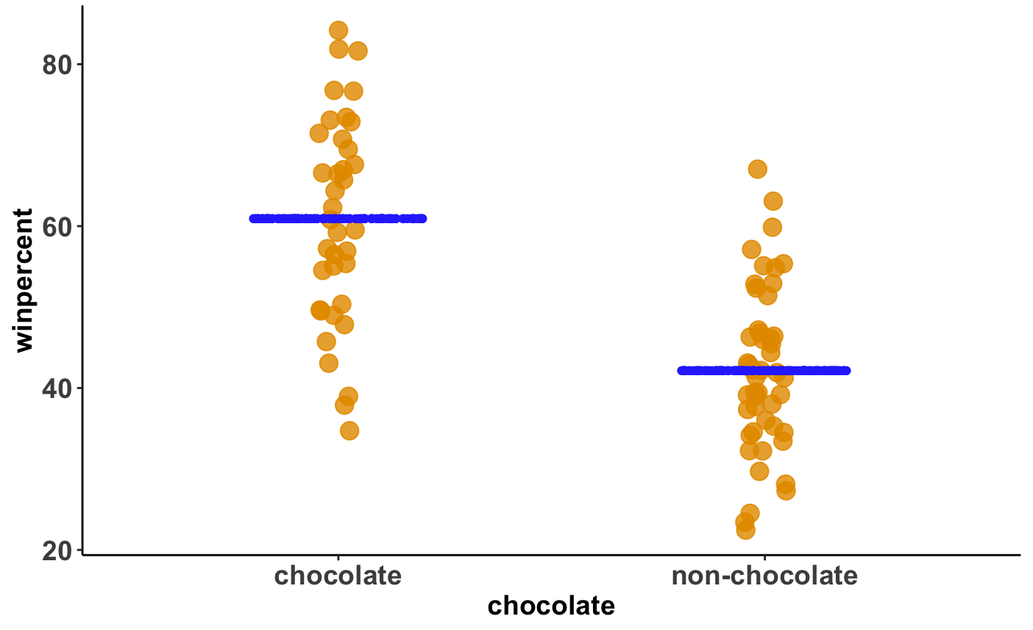
Repeated Practice Representing, Coordinating, and Adapting a Small Number of Core Concepts...
DATA = MODEL + ERROR
winpercent = chocolate + other stuff

Slide 35
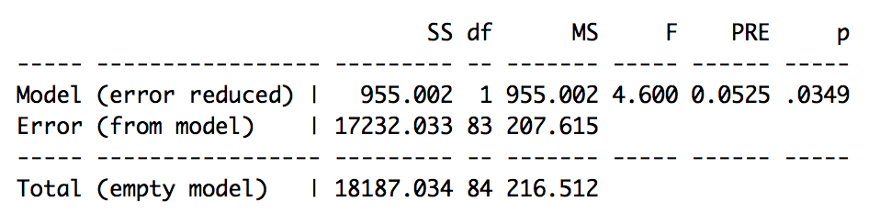
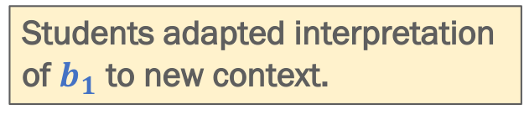
...Enhanced Learning a New Situation
(Simple Regression)
DATA = MODEL + ERROR
winpercent = chocolate + other stuff

Slide 36
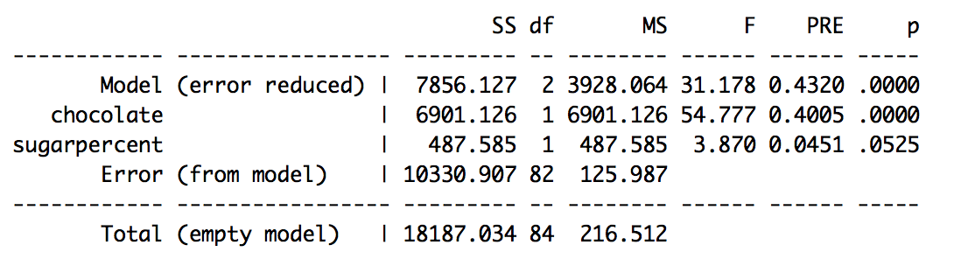
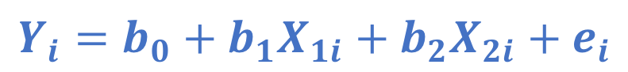
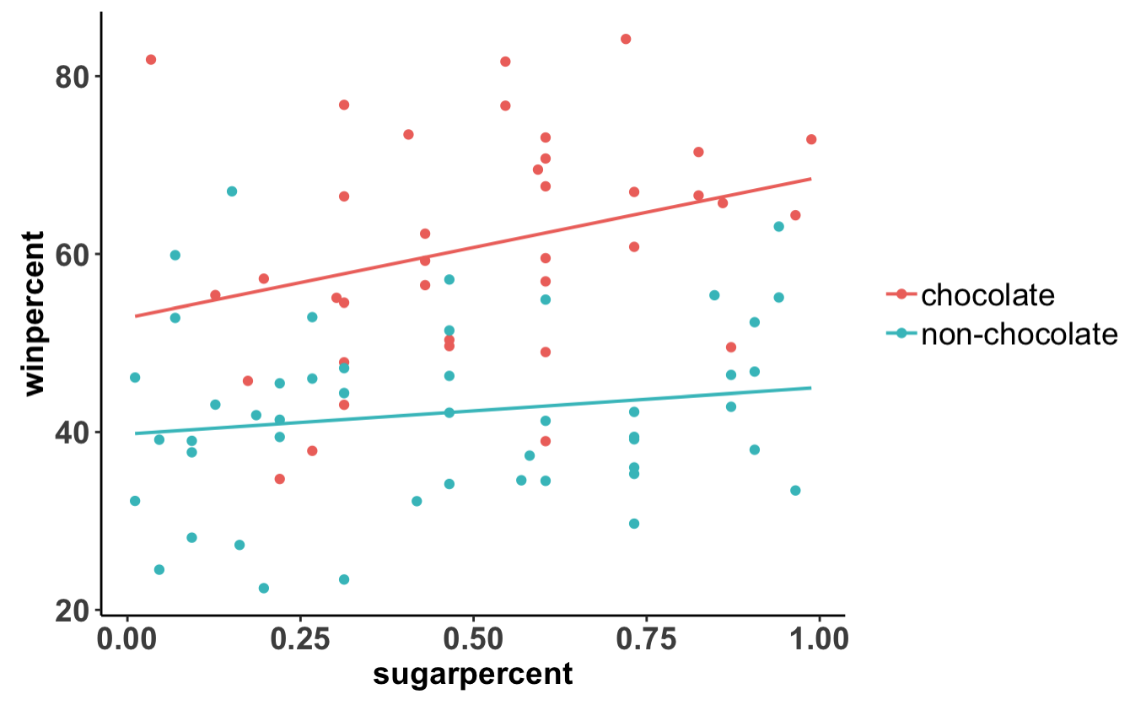
Even without direct instruction, able to think through multiple regression.
DATA = MODEL + ERROR
winpercent = chocolate + sugarpercent
+ other stuff
Notes:
Able to port over concepts relatively easily...
Total variation doesn’t change
Error is reduced by this model

Slide 37
This isn’t enough. Does the course prepare students to extend their learning?
Notes:
In the course we cover through simple regression models with single predictors
Two group models
Three group models
Simple regression models
The following questions were scored as extra credit on the final. Students knew that the information was not something that they had necessarily studied.

Slide 38
Participants
UCLA Students from two sections of the course
Fall 2018:
340 (236 female) started the course
310 (214 female) completed the final exam
Winter 2019:
214 (170 female) started the course
199 (157 female) completed the final exam
Notes:
No differences in pattern across the samples

Slide 39
Materials and Context
Just completed final exam
fivethirtyeight::candy_rankings
Exam had multiple problems regarding this dataset
supernova::supernova()
Students work with this package all course

Slide 40
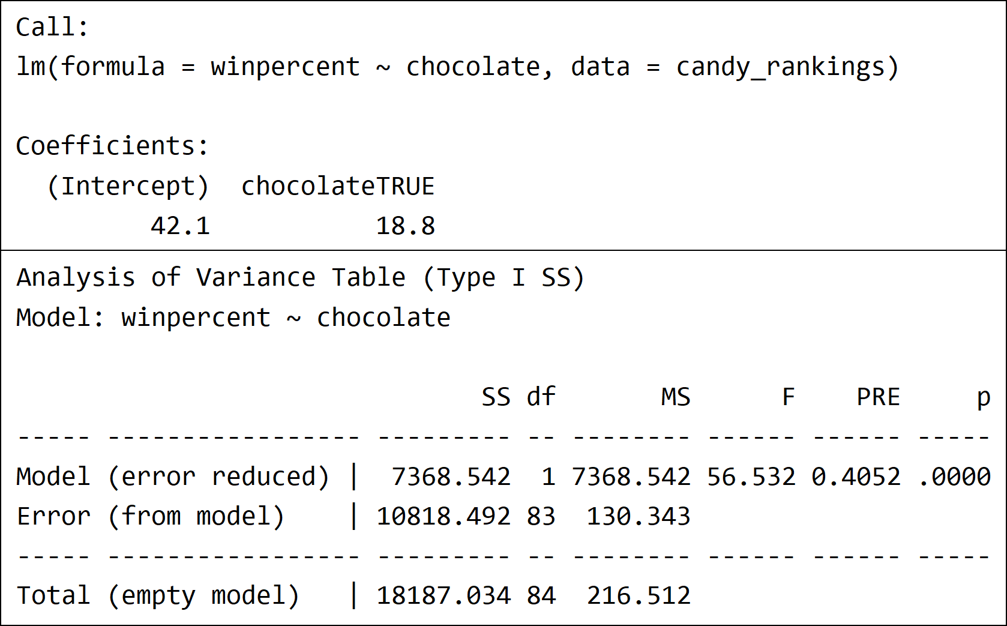
lm() and supernova() output

Slide 41
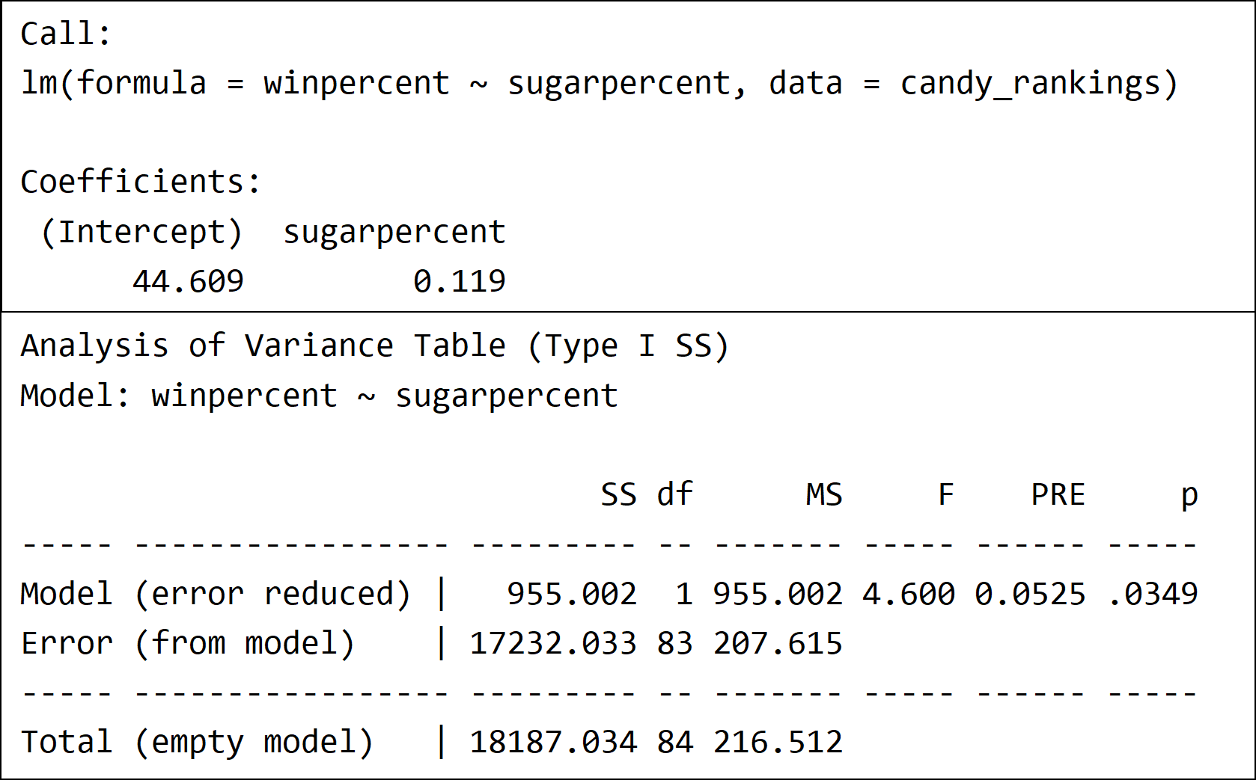
Q1.
These are two models explaining winpercent… … represent the two-­predictor model in GLM notation

Slide 42
Represent the two-predictor model using GLM notation
Feature | Example | Prop.
Completely correct | yi = b0 + b1*X1i + b2* X2i + ei yi = b0 + b1X1i + b2X2i + ei yi = b0 + b1(X1i) + b2(X2i) + ei | 0.531
A single outcome variable* | yi = b0 + b1*X1i + b2* X2i + ei Not: b0 + b1*X1i + b2* X2i + ei | 0.985
A single error term* | yi = b0 + ei Not: yi = b0 | 0.945
Only used one predictor | yi = b0 + b1*Xi + b2 + e | 0.303
Used the same predictor twice | yi = b1*Xi + b2*Xi | 0.246
DATA = [ MODEL ] + ERROR
winpercent = [ chocolate + sugarpercent ] + other stuff

Slide 43
Represent the two-predictor model using GLM notation
Feature | Example | Prop.
Completely correct | yi = b0 + b1*X1i + b2* X2i + ei yi = b0 + b1X1i + b2X2i + ei yi = b0 + b1(X1i) + b2(X2i) + ei | 0.531
A single outcome variable* | yi = b0 + b1*X1i + b2* X2i + ei Not: b0 + b1*X1i + b2* X2i + ei | 0.985
A single error term* | yi = b0 + ei Not: yi = b0 | 0.945
Only used one predictor | yi = b0 + b1*Xi + b2 + e | 0.303
Used the same predictor twice | yi = b1*Xi + b2*Xi | 0.246

Slide 44
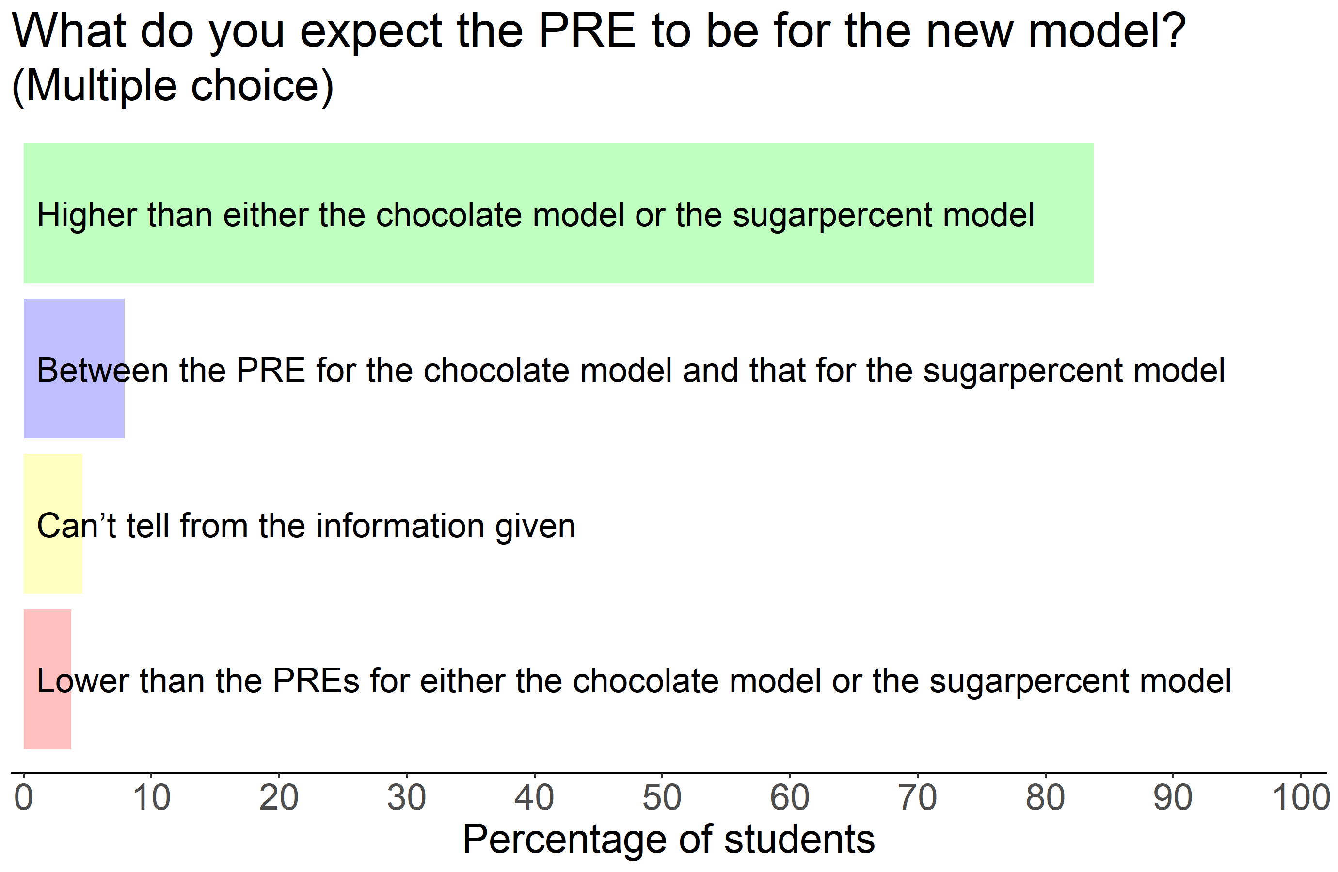
Thinking about the new two-predictor model

Slide 45
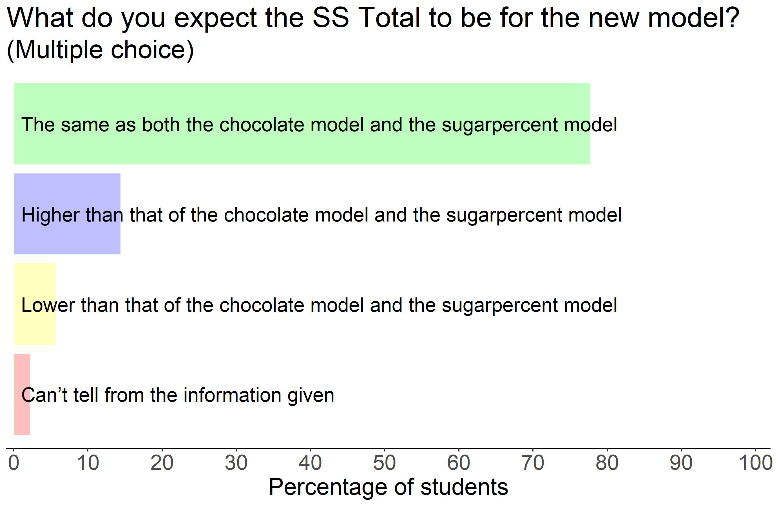
Thinking about the new two-predictor model

Slide 46
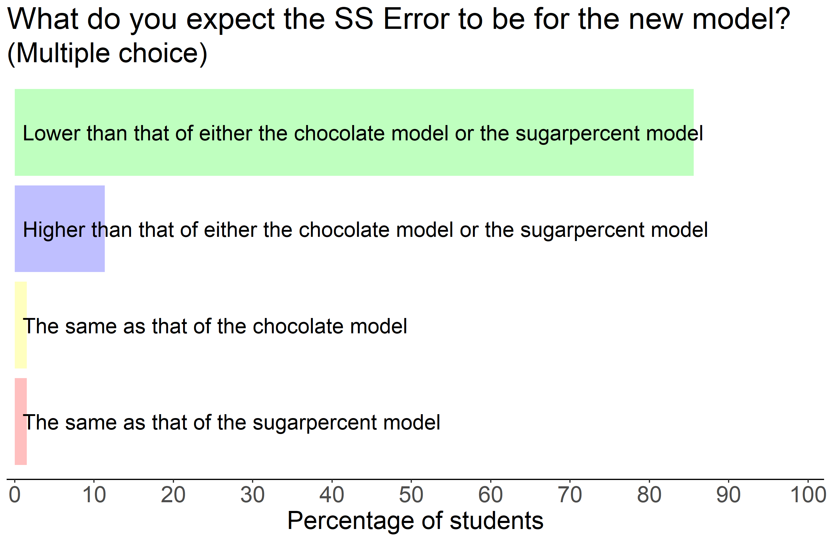
Thinking about the new two-predictor model

Slide 47
Why is the SSE smaller for the new model?
Concept | Prop.
This model explains more variation / error | 0.689
Multiple explanatory variables / more complex | 0.636
SS Model is larger | 0.197
There is less error “leftover” | 0.186
Combined models explain more | 0.140

Slide 48
Concept | Proportion
This model explains more variation / error | 0.689
Multiple explanatory variables / more complex | 0.636
SS Model is larger | 0.197
There is less error “leftover” | 0.186
Combined models explain more | 0.140
A notion of “distance” to the model (or deviation from) | 0.077
SS Total is the same | 0.072
The model makes better predictions / is more accurate | 0.050
There is a greater reduction in error from the empty model | 0.050
PRE is larger | 0.042
There is a cost to adding new variables | 0.029
The model is not necessarily better | 0.026
Explains more, but the variables might overlap | 0.020
Using two statistically significant predictors | 0.013
(Students that had none of these) | 0.050

Slide 49
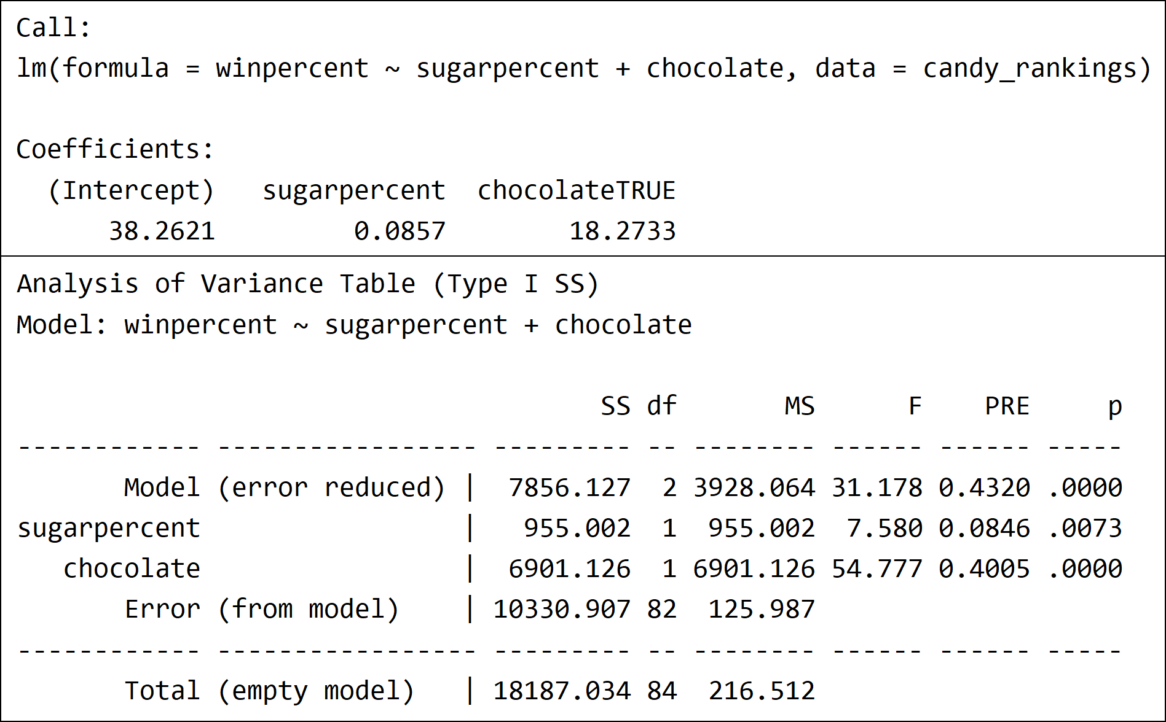
Given the full model and related output

Slide 50
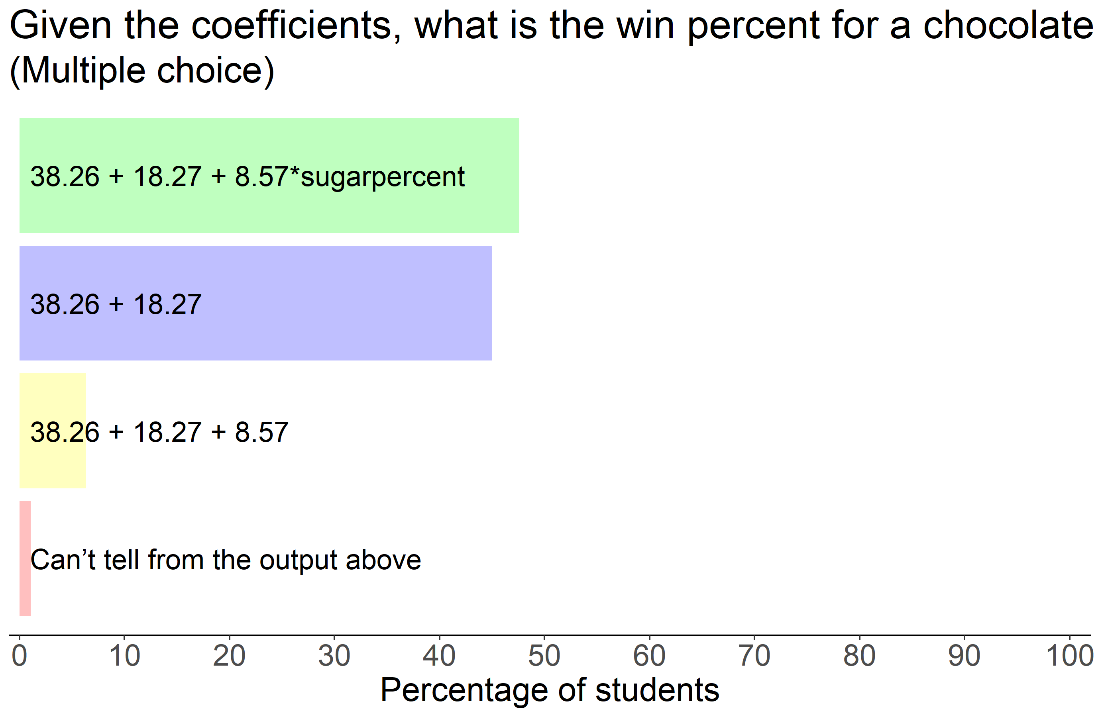
Given the full model and related output

Slide 51
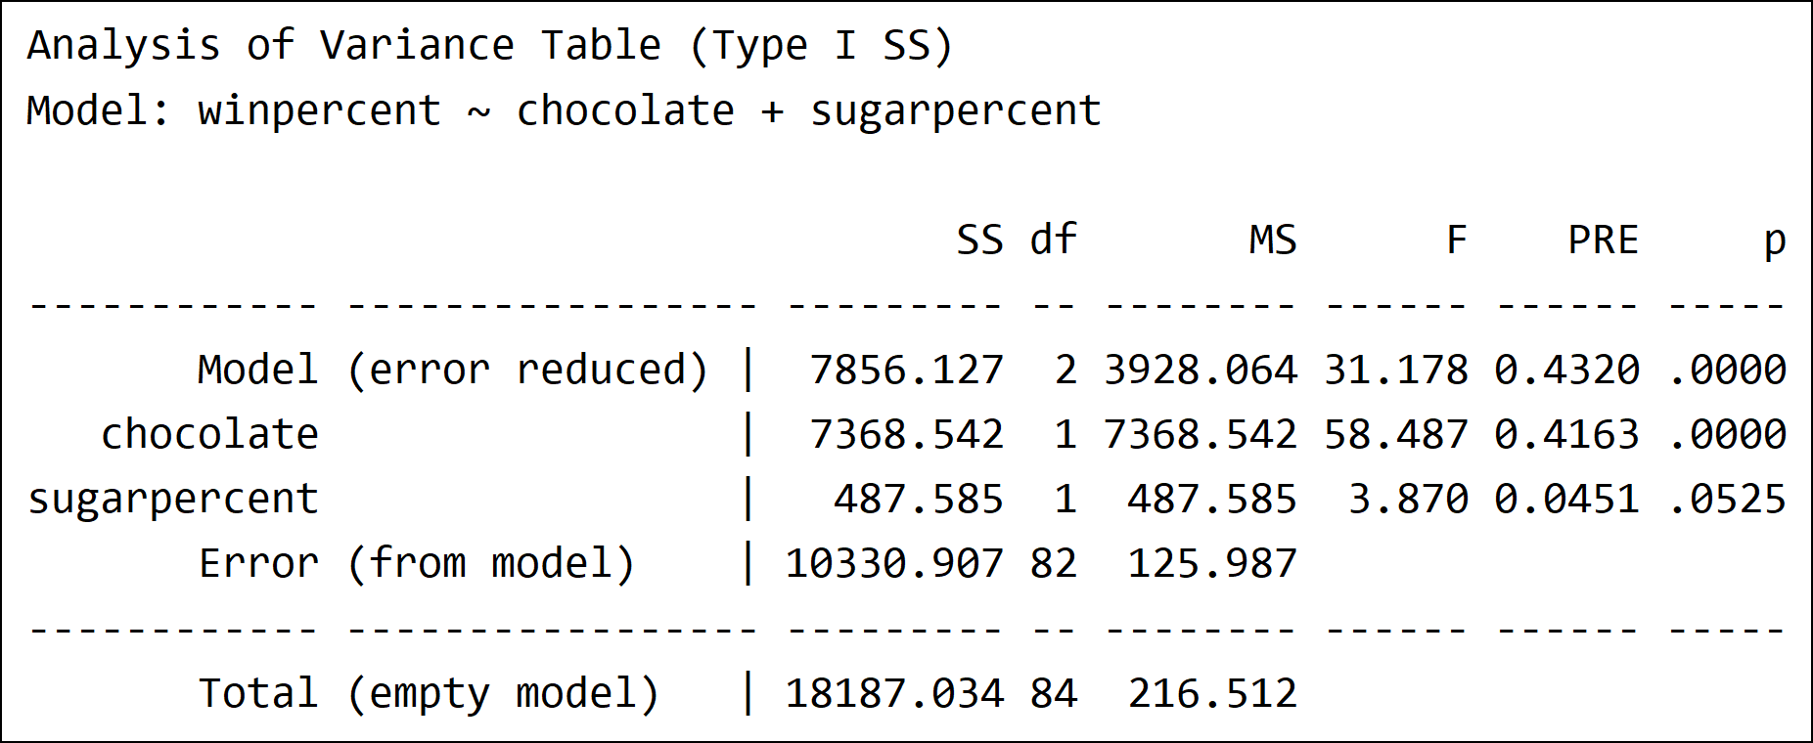
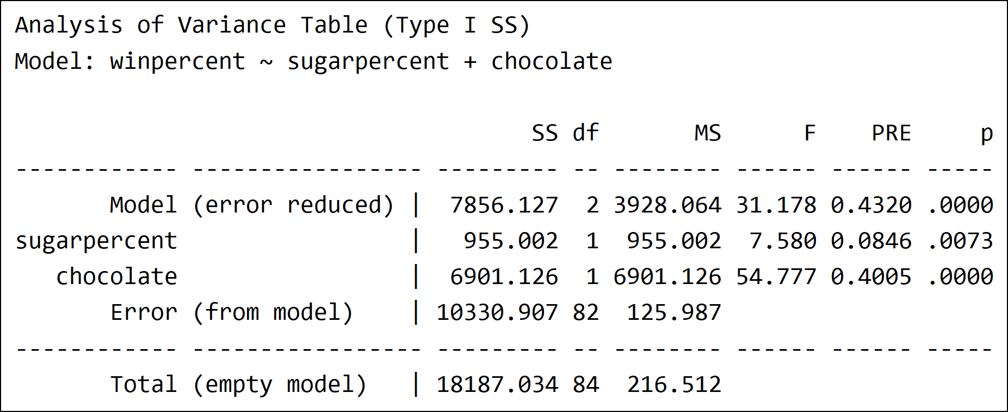
Given the full model fit in different orders

Slide 52
Why does the order matter?
Concept | Prop.
First variable “gets” more of the variation | 0.312
Second variable explains the “left over” variation | 0.269
The variation that is available to be explained is changing during the process | 0.195
One variable is better at explaining | 0.121
The variables overlap in what they can explain | 0.101

Slide 53
Why does the order matter?
Concept | Prop.
First variable “gets” more of the variation | 0.312
Second variable explains the “left over” variation | 0.269
The variation that is available to be explained is changing during the process | 0.195
One variable is better at explaining | 0.121
The variables overlap in what they can explain | 0.101

Slide 54
Concept | Proportion
First variable “gets” more of the variation | 0.312
Second variable explains the “left over” variation | 0.269
The variation that is available to be explained is changing during the process | 0.195
One variable is better at explaining | 0.121
The variables overlap in what they can explain | 0.101
The difference is due to sampling variation | 0.094
The coefficients change | 0.047
The first variable gets to explain any overlap | 0.045
The outcome and explanatory variables reversed | 0.038
One of the variables is quantitative vs. qualitative | 0.022
(Students that had none of these) | 0.296
(Misunderstood) | 0.047

Slide 55
Very promising!

Slide 56
Moving Forward

Slide 57
What keeps us up at night?
32% of CA’s 11th graders were conditionally ready or ready for college level math.
2017 test-takers, data from Public Policy Institute of California, https://www.ppic.org
Notes:
Knowledge that most students end up with now is very brittle; inert; and often students feel demoralized by the experience.
Using practicing connections approach -- the hope is for education to result in robust, flexible, and transferable learning.

Slide 58
Acknowledgements

Slide 59


Funding Sources
California Learning Lab

Slide 60
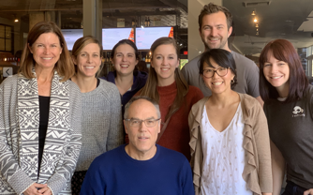

The UCLA
Teaching and Learning Lab
uclatall.com
CourseKata.org

Slide 61
The Problem: Putting Research into Practice
Notes:
We know a lot about how students learn in 1-hour settings
- we know that if we test them repeatedly over time, they learn things faster
- we know that they don’t always have good intuitions about how learning truly works
- we know that spacing and interleaving and blocking all have independent effects in different contexts
What do we know about teaching hard things that take time to learn? On the order of semesters and quarters?

Slide 62
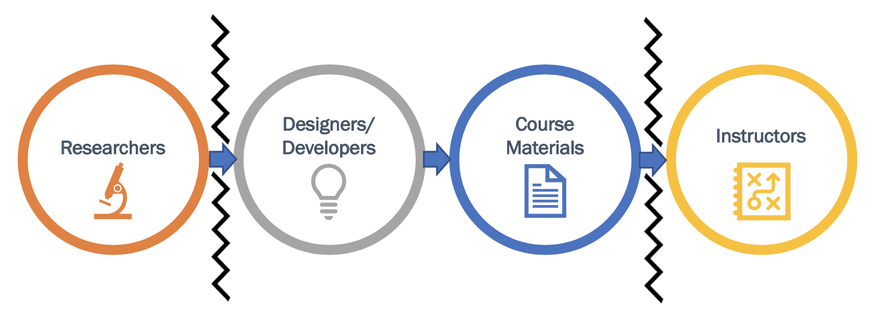
Research to Practice: Silos
Ideas vs.
Implementation
Notes:
Educational research is highly siloed
- researchers have fantastic ideas but this isn’t the whole picture
- research is done in one-hour windows, possibly with a call back. Is this truly educational research?
Developers do not always implement researchers’ ides in effective ways
Instructors often
- do not know the research
- do not have the tools to implement the research
- do not have the ability to implement the research
- are faced with the impossibility of implementing the research

Slide 63
The Better Book Approach
Stigler, J. W., Son, J. Y., Givvin, K. B. Blake, A. B., Fries, L. C., Shaw, S. T. & Tucker, M. C. (in press).
The ​Better Book​ Approach for Education Research and Development.
Teachers College Record, 123(2).

Slide 64
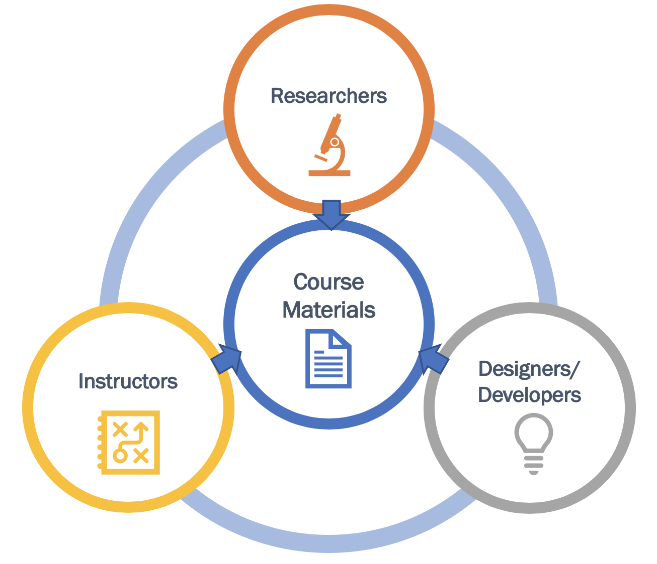
Vision: Better Book
Build R&D communities around development and continuous improvement of online learning resources
Notes:
The basic idea is to leverage the affordances of being able to put learning materials online:
Interactive
Gather student responses
Give different versions to different individual students
Then build settings, routines, technologies to support collaborations among the key contributors.
Different people are needed more or less during different phases.
Note: changing roles:
Researchers - applying their skills to translational research
Instructors - not just people to implement with fidelity for a test; not to figure out IF it works, but HOW to make it work for their students.
Designers/developers - from prototyping, to usability, to differentiation.

Slide 65
Strategy: Learn By Doing
Introduction to Statistics:
A Modeling Approach
Son & Stigler
Son & Stigler
Notes:
Start with statistics.
Made it mediocre!

Slide 66
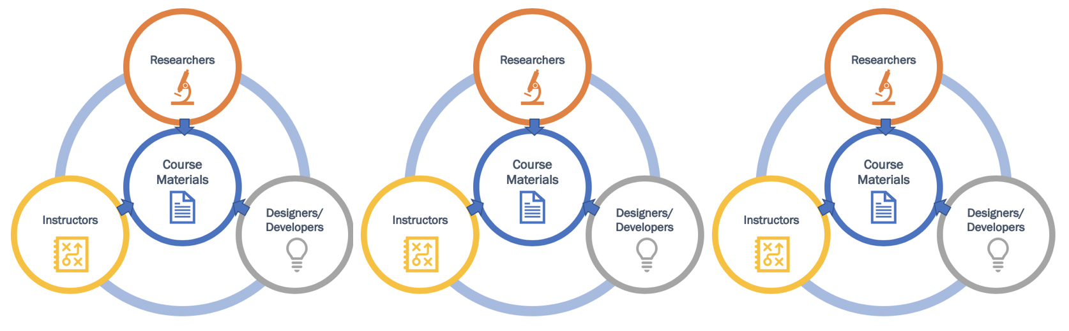
Phases of Work
Innovation
Minimum viable system
Implementation
20/80 Rule
Personalization
Adaptive interventions
Notes:
Different people are needed more or less during different phases.
Note: changing roles:
Researchers - applying their skills to translational research
Instructors - not just people to implement with fidelity for a test; not to figure out IF it works, but HOW to make it work for their students.
Designers/developers - from prototyping, to usability, to differentiation.

